Slide 1
Project Horizon “Broadening Horizons, Shaping Your Future” By RED BLACK TECHNOLOGIES
Group Members
22i-1042 Maaz Ali
22i-1053 Huzaifa Nasir
22i-0763 Kaf Abbas

Slide 2
Overview
Introduction
Functional Requirements
Non Functional Requirements
Use case
Component Diagram
Class Diagram
Deployment Diagram
Design Pattern
GUI Screen Shots

Slide 3

A Scholarship Platform for Pakistani Students

Slide 4

The Struggle to find Scholarships
Project Horizon solves this problem by making a centralized platform for BS, MS, and Phd students to apply for their dream scholarships.

Slide 5
Functional Requirements
For Students
Scholarship Application
Application Tracking
Notifications
Account Management

Slide 6
Functional Requirements
For Administrators
Scholarship Management
Application Processing
User Management
Reporting

Slide 7
Functional Requirements
For Guest User
Scholarship Search
Scholarship View

Slide 8
Non Functional Requirements
Performance
Scalability
Security
User Friendly

Slide 9
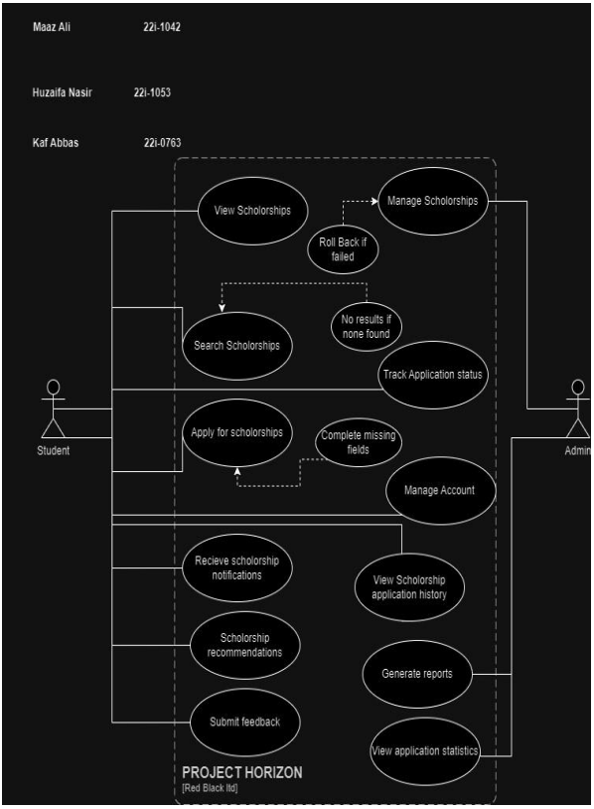
USECASES

Slide 10
Use cases
Manage Scholarship
Admin wants to keep scholarship data up to date.
Students rely on the accuracy and timeliness of scholarship listings.
View Scholarships
Students want to view available scholarships.
Admin ensures system provides accurate scholarship listings

Slide 11
Use cases
Search Scholarship
Admin ensures search functionality is accurate and efficient.
Students wants to search scholarships.
Apply for Scholarships
Students want to apply for scholarships they are eligible for.
Admin ensures system provides accurate scholarship listings and a smooth application process.

Slide 12
Use cases
Track Application Status
Admin provides accurate status update on scholarship applications.
Students wants to keep track of their scholarship application status.
Manage Account
Students want to manage their profile.
Admin ensures system stores data without compromising security and integrity.

Slide 13
Use cases
Receive scholarship notifications
Admin provides accurate notifications.
Students wants to receive timely notifications about new scholarship and status update.
View Application History
Students want to review application History.
Admin ensures accurate record keeping.

Slide 14
Use cases
Generate Reports
Admin wants to generate reports.
Students indirectly benefit from improvement based on reports.
Submit Feedback
Students want to provide feedback on their experience.
Admin ensures improvement in system based on the feedback.

Slide 15
Use cases
View Application Statistics
Admin wants to view statistics on how many students have applied for specific scholarships, unpopular scholarships and user engagement.
Students indirectly benefit from improvement based on this data.

Slide 16
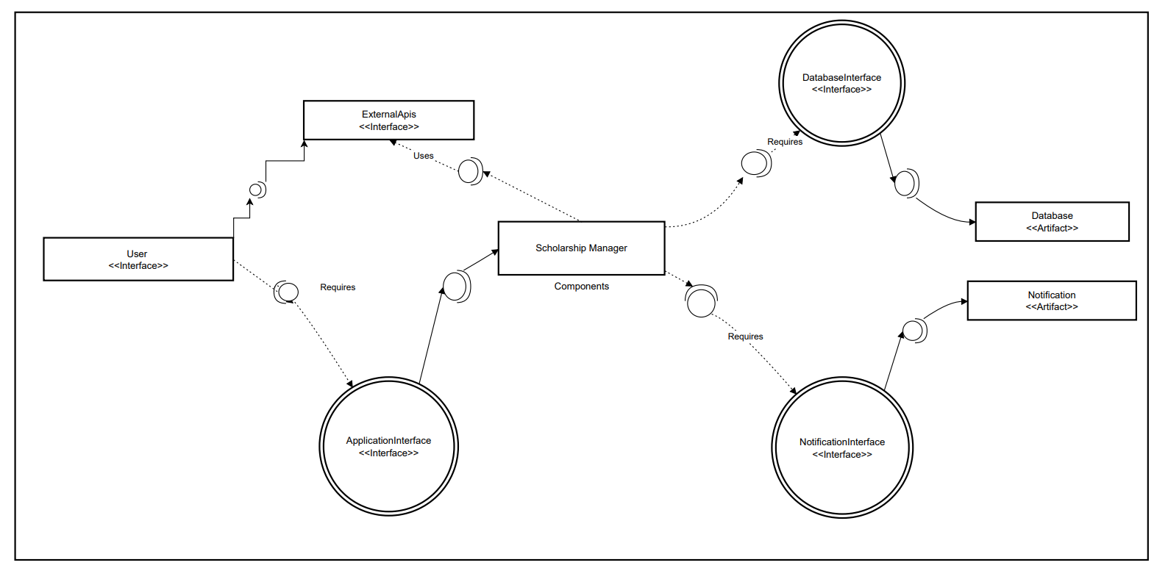
Component Diagram

Slide 17
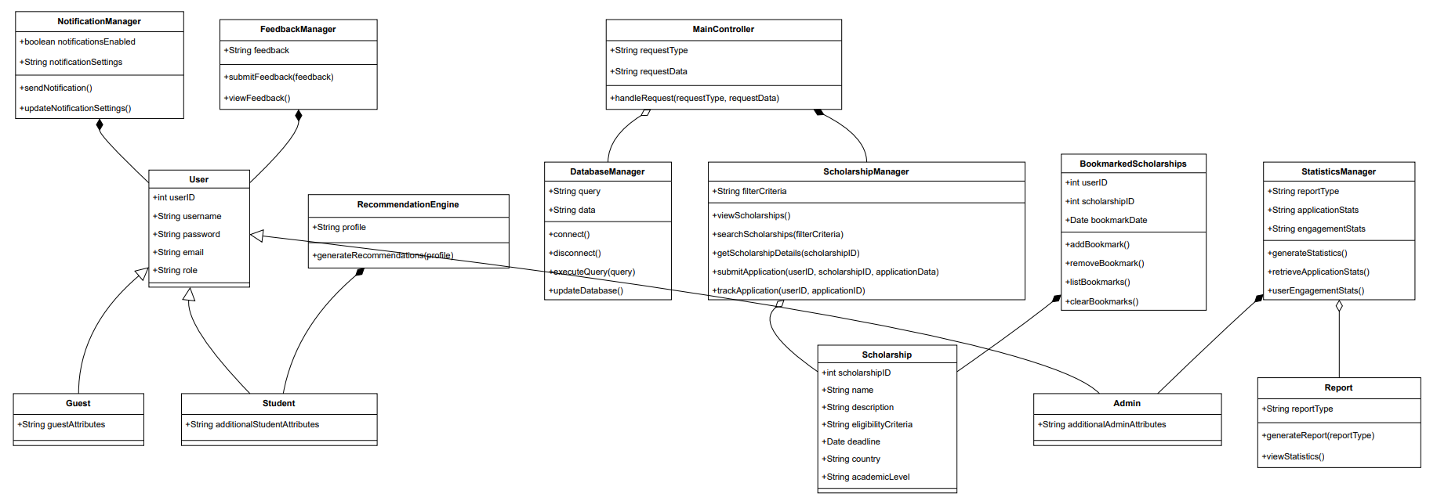
Class Diagram

Slide 18
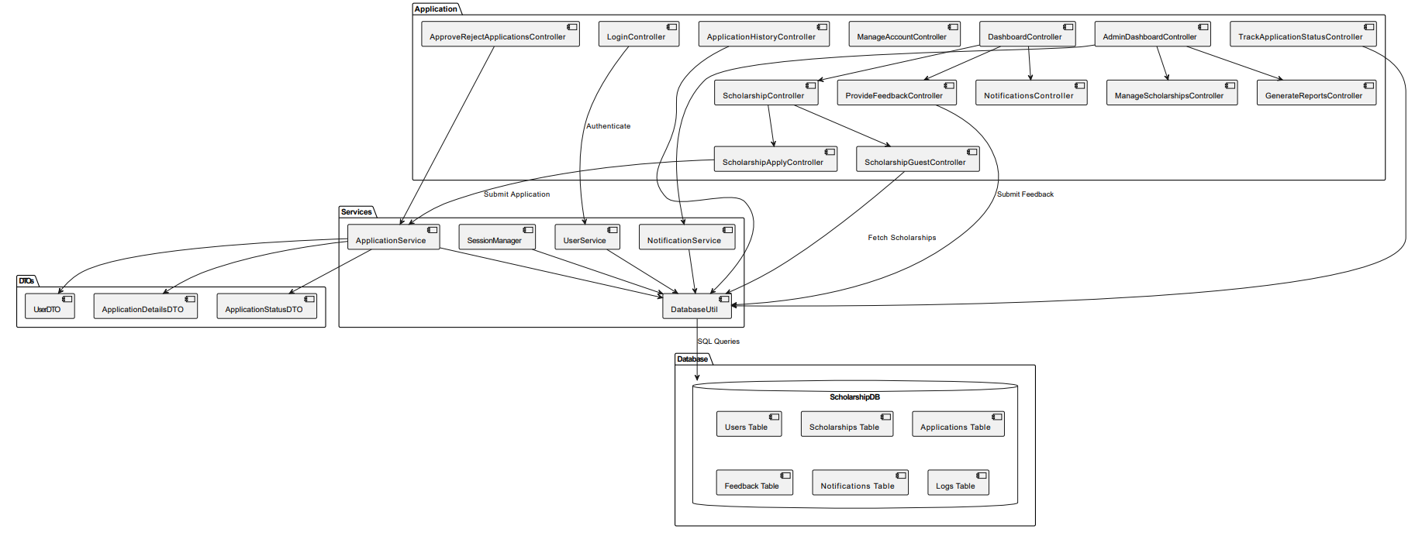

Deployment Diagram

Slide 19
Design Patterns
The system leverages GoF (Gang of Four) and GRASP (General Responsibility Assignment Software Patterns) principles for modular and maintainable code.

Slide 20
GoF
Strategy
Method
Used in:
GenerateReportsController
ScholarshipsOverviewReportStrategy: Generates the "Scholarships Overview" report.
StudentParticipationReportStrategy: Generates the "Student Participation" report.
SystemUsageStatisticsReportStrategy: Generates the "System Usage Statistics" report.

Slide 21
GoF
Facade
Method
Where It's Used:
UserFacade Class:
Acts as the facade, centralizing and simplifying access to user-related operations like login and signup.
Hides the complexity of UserService and its underlying logic.
LoginController Class:
Instead of interacting directly with UserService, it calls methods on UserFacade for operations like login and signup.
Keeps the controller code cleaner and more focused on user interaction.

Slide 22
GoF
Observer
Used in:
Notification System
Observes updates in scholarship data and notifies students in realtime.

Slide 23
GoF
Singleton
Used in:
DatabaseUtil to make a single instance of Database Manager

Slide 24
GRASP
Controler
Used in:
LoginController, ScholarshipControler and AdminDashboardController.
Information Expert
Used in:
Application: Holds Application data including statuses and associated user information.
Scholarship: Encapsulates scholarship-specific data, such as eligibility and requirements

Slide 25
GRASP
Creator
Used in:
DatabaseUtil: Creates objects like Scholarship, Application, and Notification when retrieving data from the database.
High Cohesion
Used in:
Feedback: focuses solely on feedback management.
Notification: deals exclusively with notifications.

Slide 26
GRASP
Low Coupling
Used in:
Views and models are loosely coupled through controllers, enhancing maintainability.
Poly-
Morphism
Used in:
Scholarship controller and ScholarshipGuestController.
Both handle viewing scholarship but differ in functionality.
Only students can apply for scholarships, but guest cannot.

Slide 27
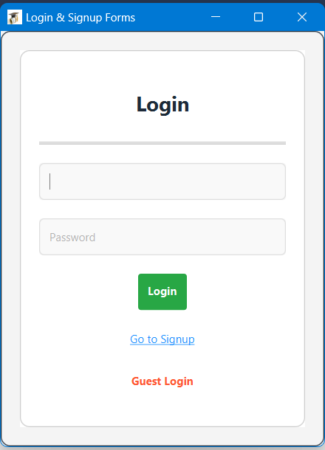
GUI

Slide 28
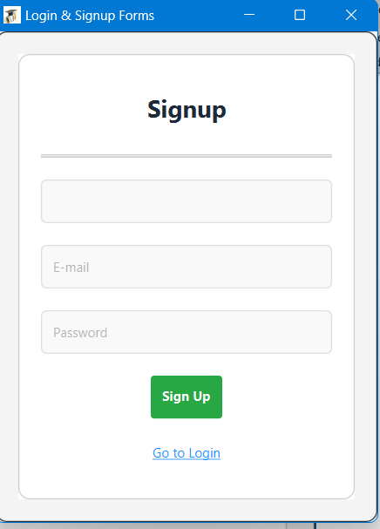
GUI

Slide 29
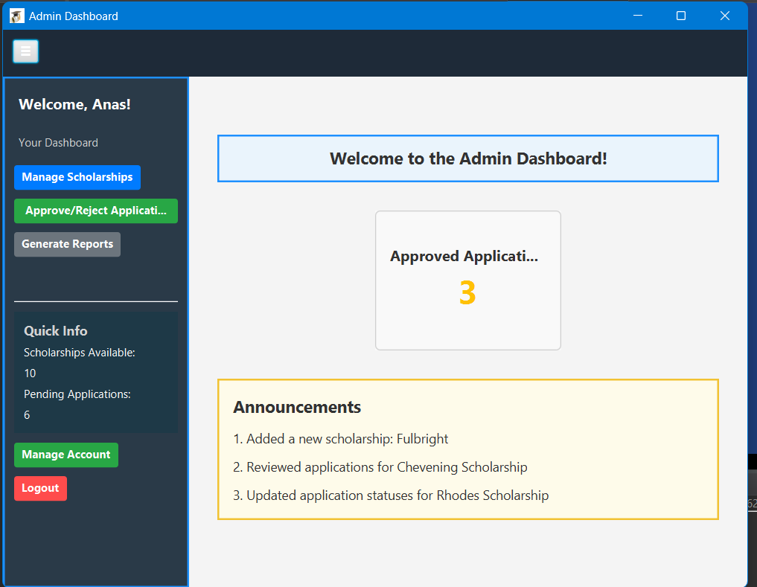
GUI

Slide 30
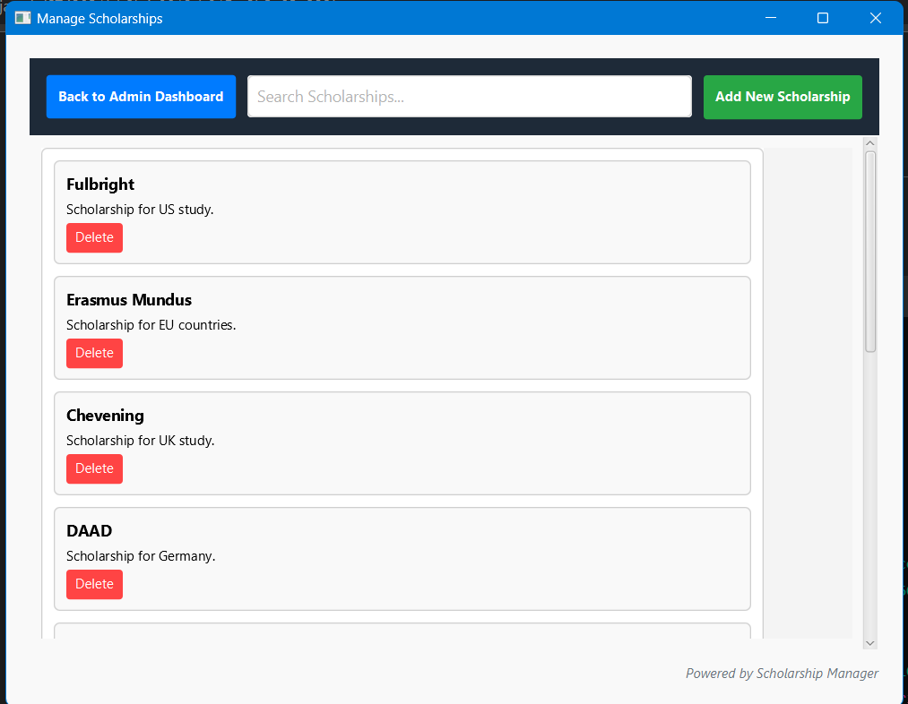
GUI

Slide 31
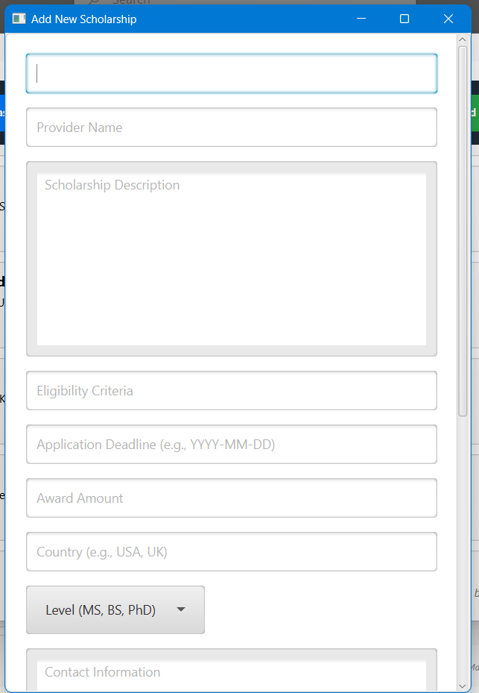
GUI

Slide 32
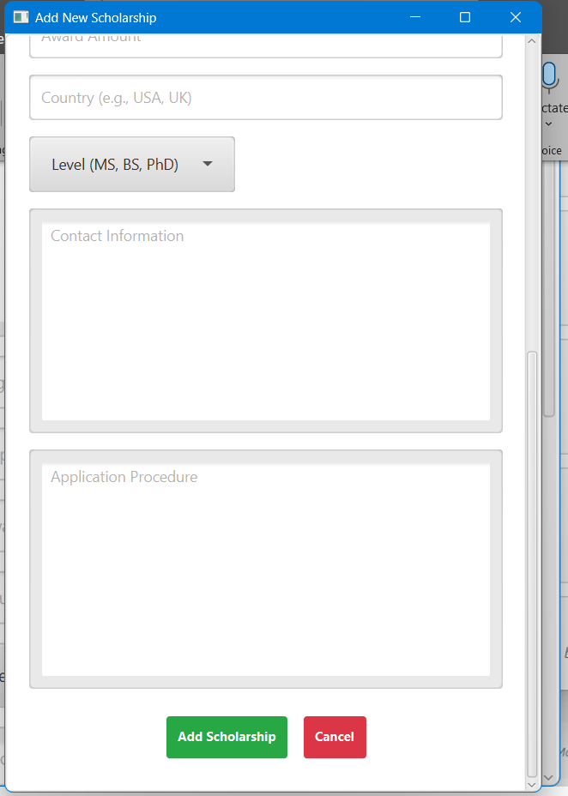
GUI

Slide 33
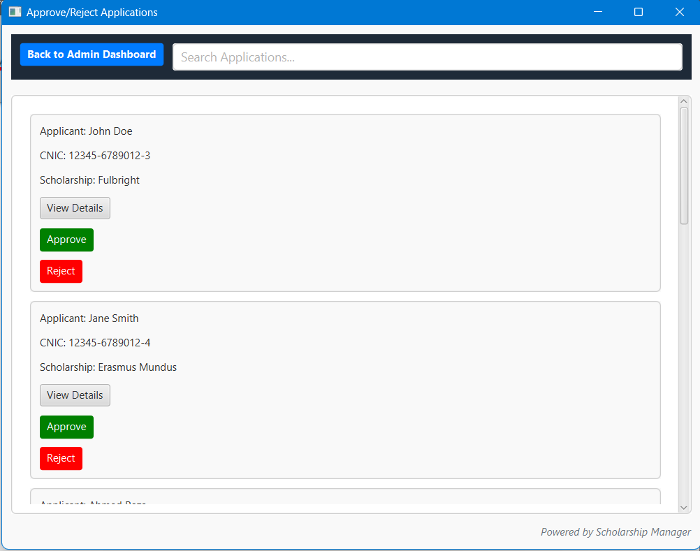
GUI

Slide 34
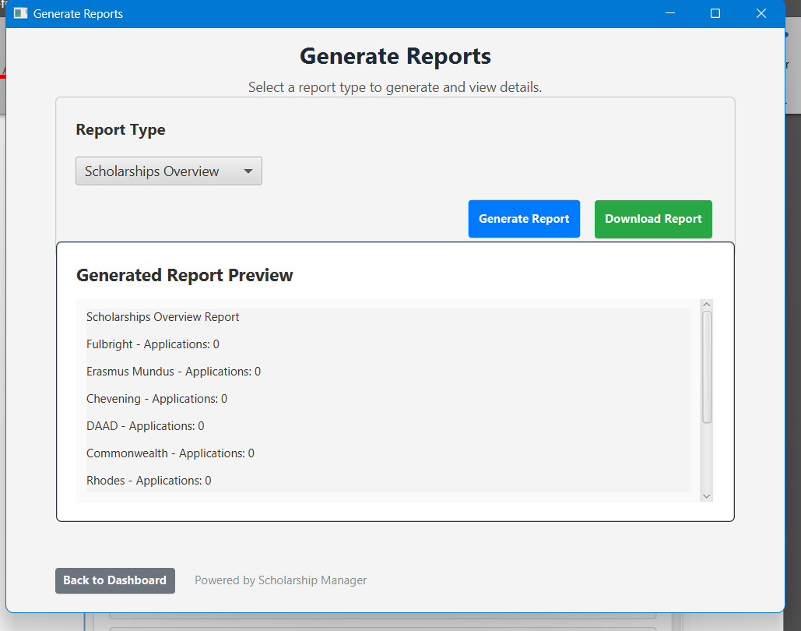
GUI

Slide 35
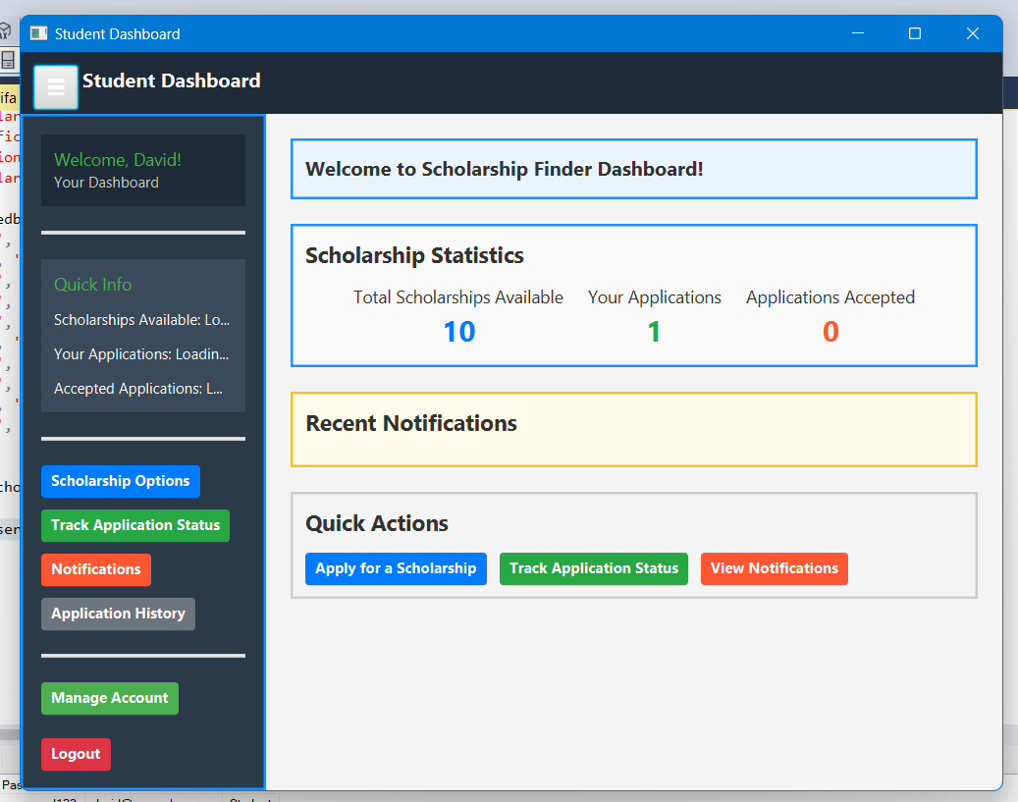
GUI

Slide 36
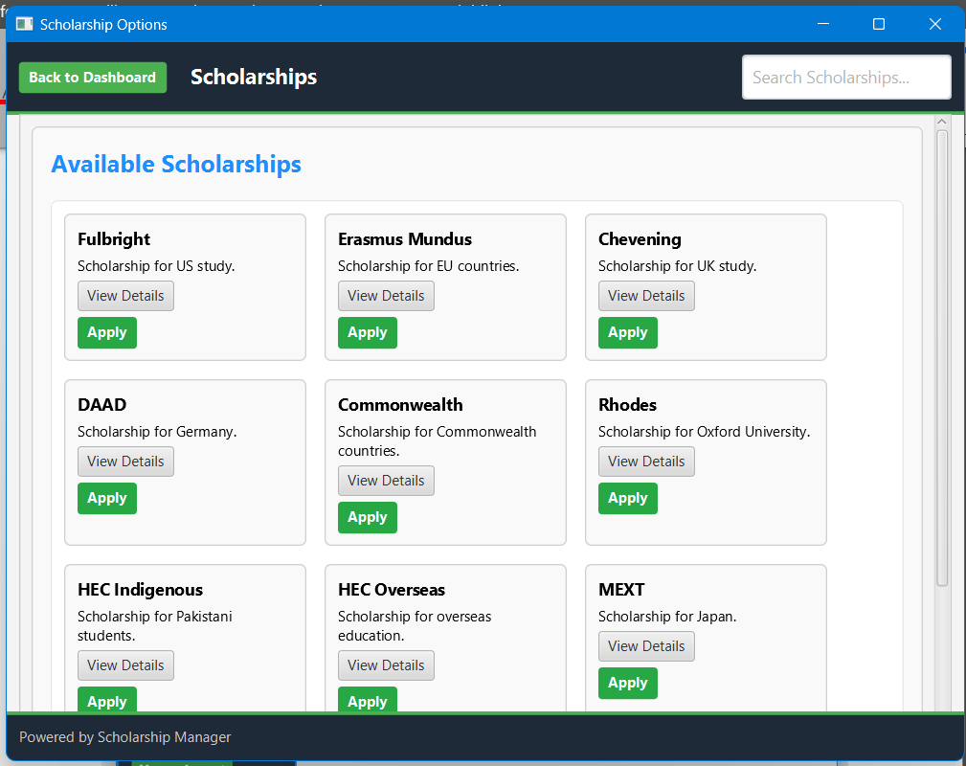
GUI

Slide 37
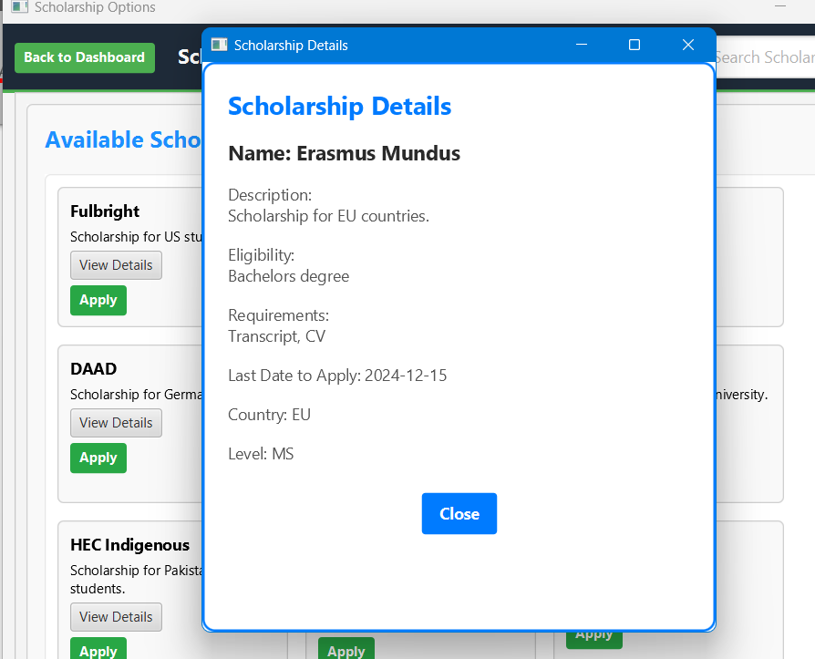
GUI

Slide 38
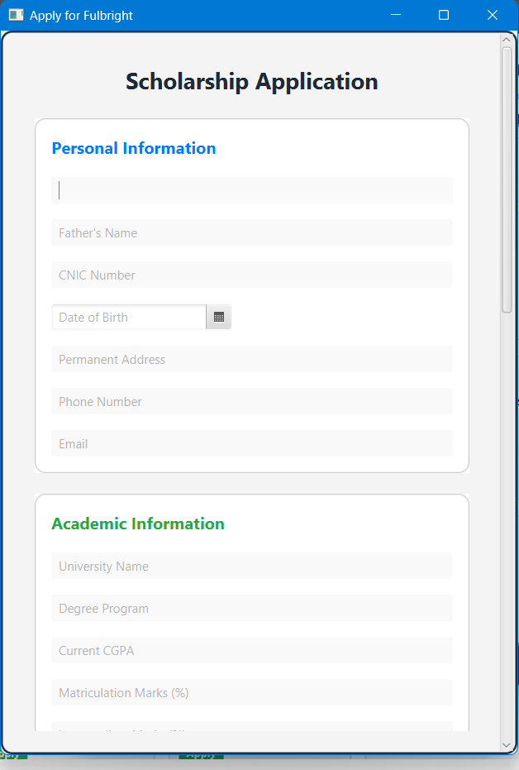
GUI

Slide 39
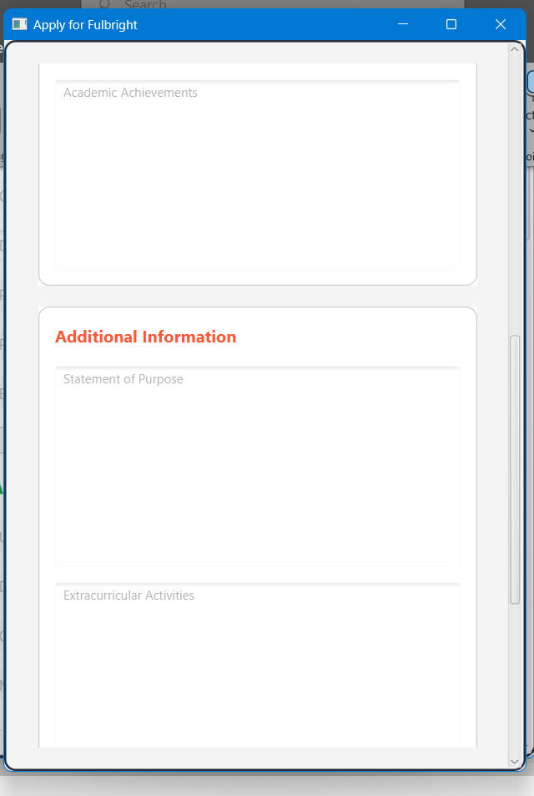
GUI

Slide 40
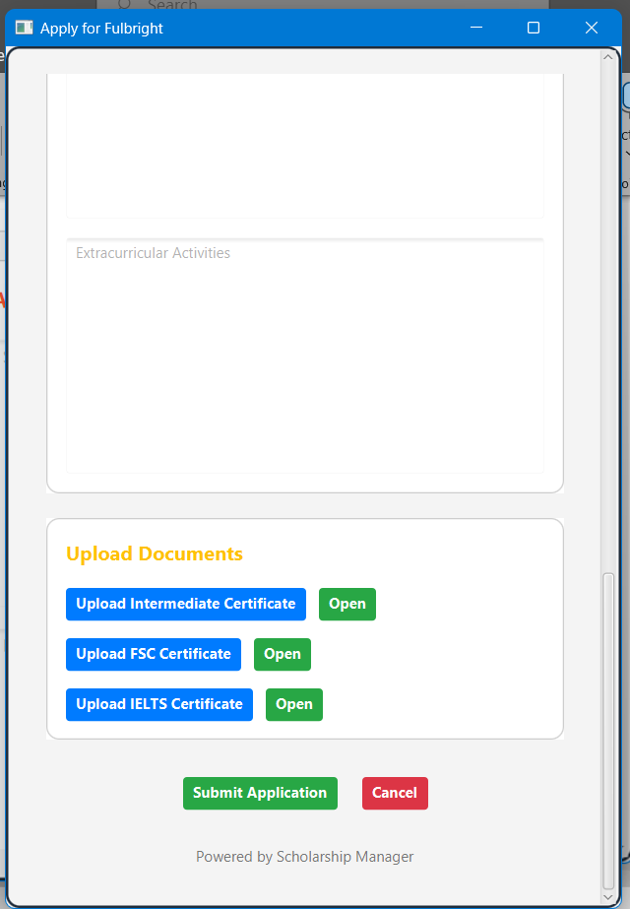
GUI

Slide 41
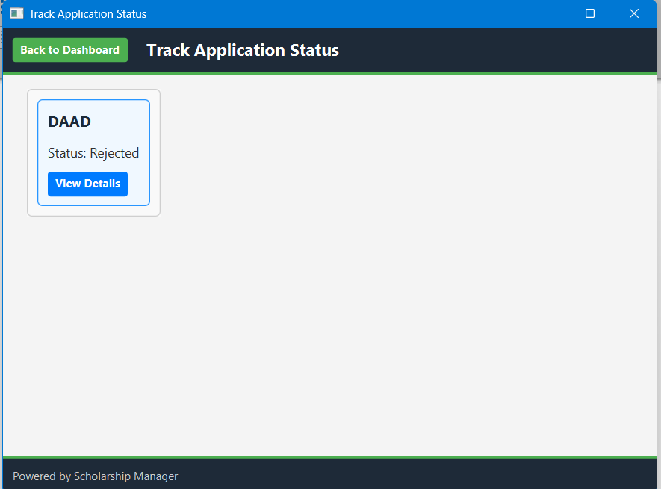
GUI

Slide 42
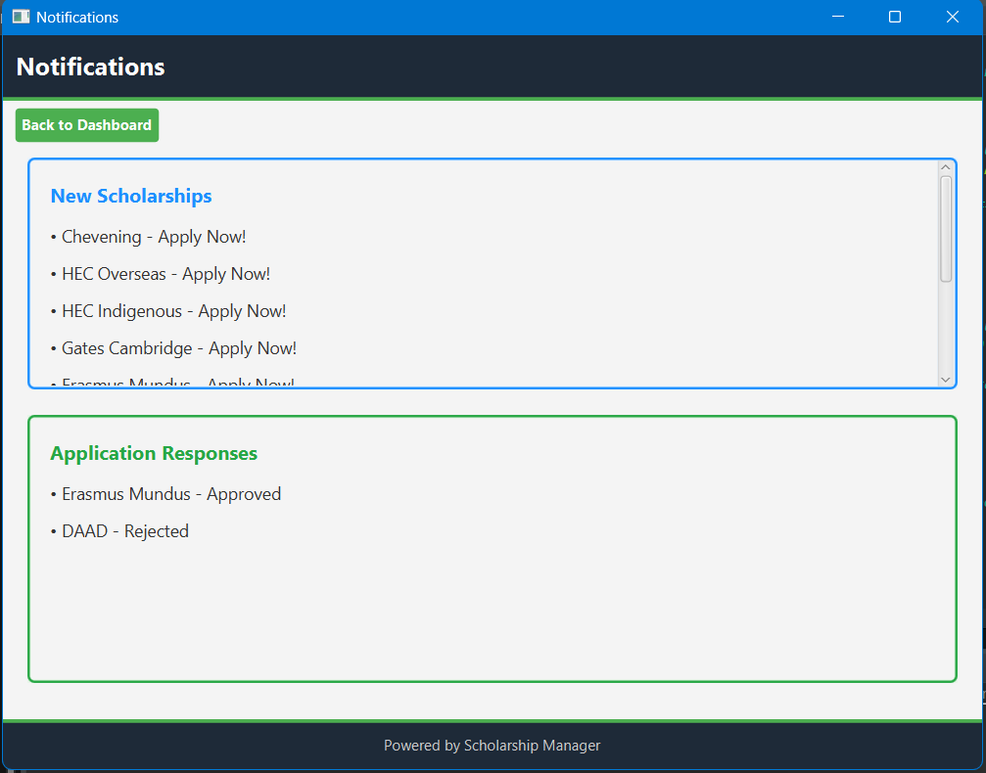
GUI

Slide 43
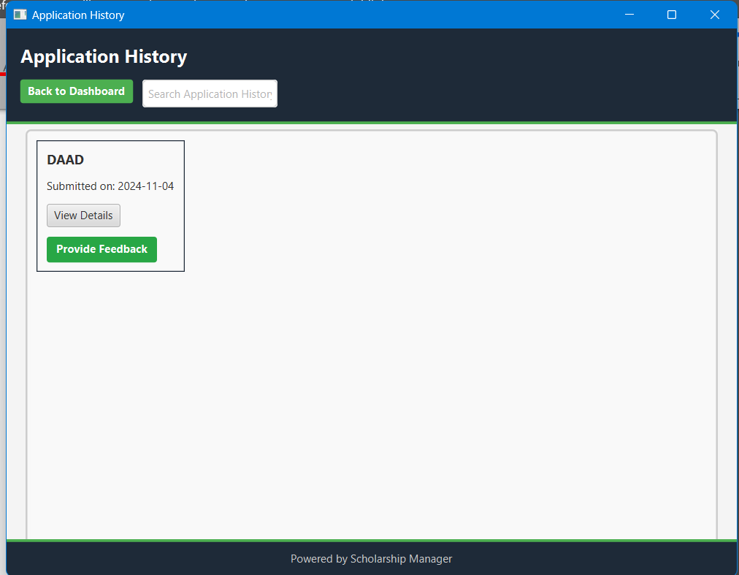
GUI

Slide 44
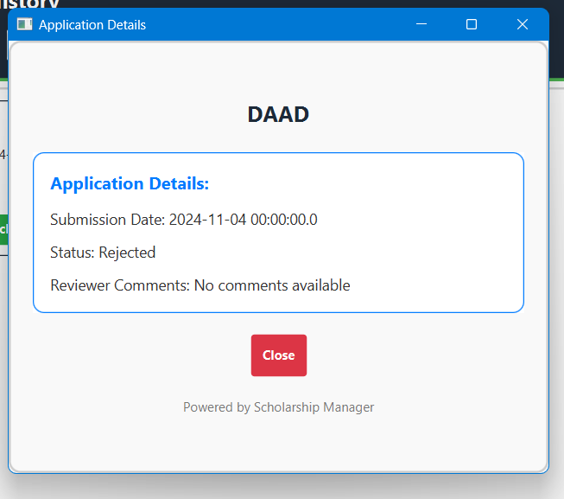
GUI

Slide 45
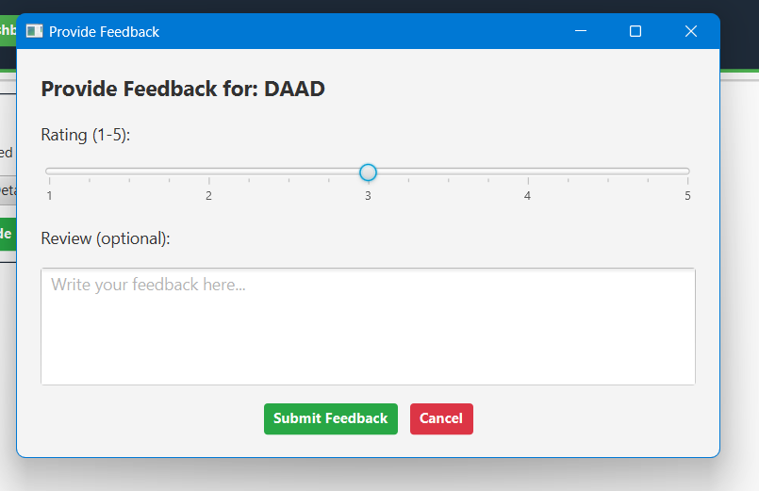
GUI

Slide 46
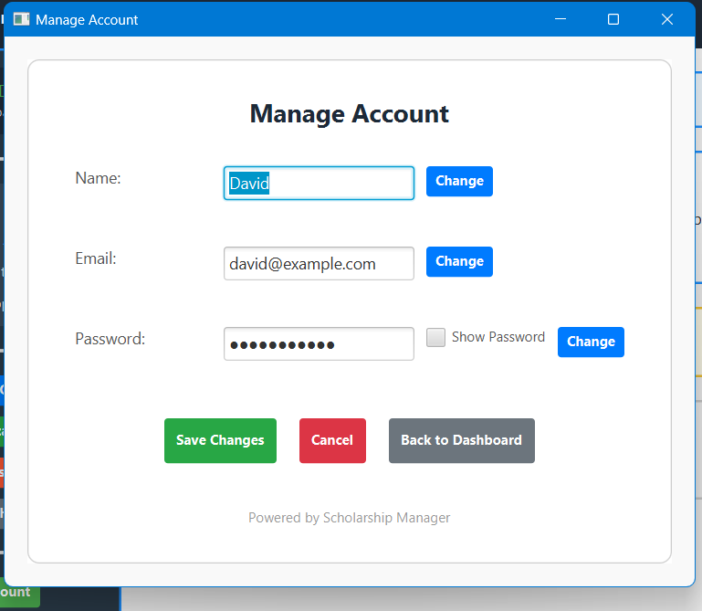
GUI

Slide 47
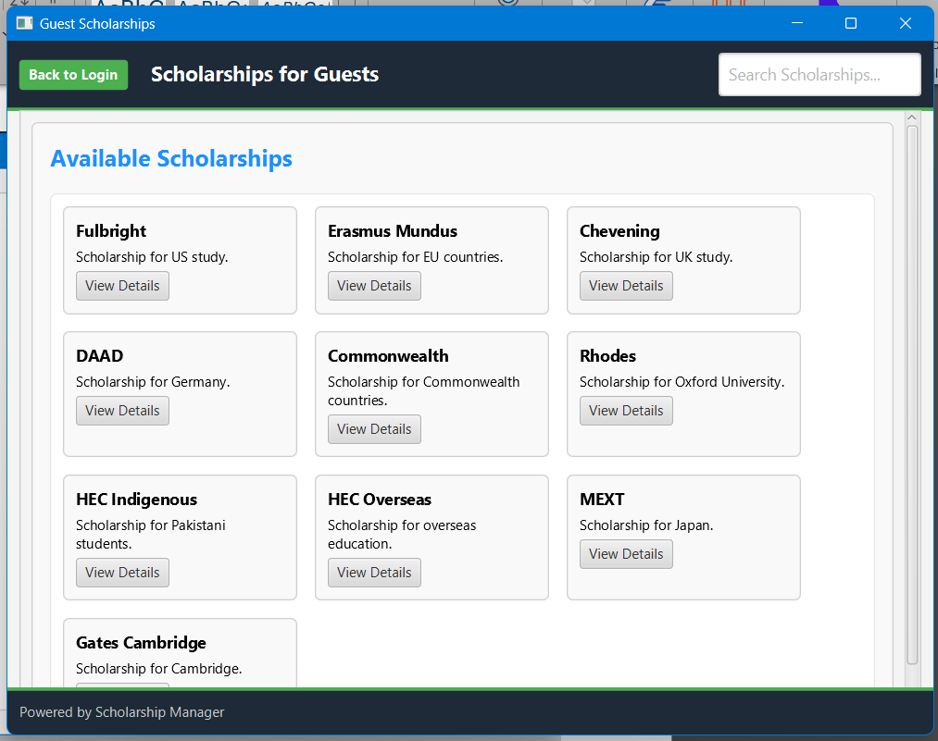
GUI

Slide 48
Thank you

